Slide 1

Project TIME Management
Dr. Uzair Iqbal, CS Dept., CIIT, Islamabad
The content mainly based on the PMBOK guide, 5th edition; and Software extension to the PMBOK guide, PMI, 2013.
Notes:
NOTE:
To change the image on this slide, select the picture and delete it. Then click the Pictures icon in the placeholder to insert your own image.

Slide 2
Introduction [1/3]
Project time management for software projects is driven by risk, resource availability, business value, and the scheduling method(s) used
Understanding and selection of scheduling methods is critical
Software project schedule should remain ﬂexible throughout the project
Most of the development cost of software project is human effort
Effort: the product of people and time
Value delivered to the customer is an important factor

Slide 3
Introduction [2/3]
Scheduling methods
Structured scheduling
Well understood product requirements, related precedent work within the organization
High safety, security, or regulatory constraints
Schedule as independent variable (SAIV)
Specific date to deliver the product; otherwise the sharp decline of product value
Similar to “time boxing” in adaptive life cycles
Iterative scheduling with a backlog
Rolling wave planning for software projects based on adaptive life cycles
Adjustment to an iterative scheduling occur throughout the project life cycle

Slide 4
Introduction [3/3]
Scheduling methods
On-demand scheduling
Based on the theory-of-constraints and pull-based scheduling
No pre-scheduling
Minimize estimation activities and maximize the value of work accomplished
Portfolio management scheduling
Scheduling of projects based on prioritizing investments in software as established by criteria determined at the organizational level

Slide 5
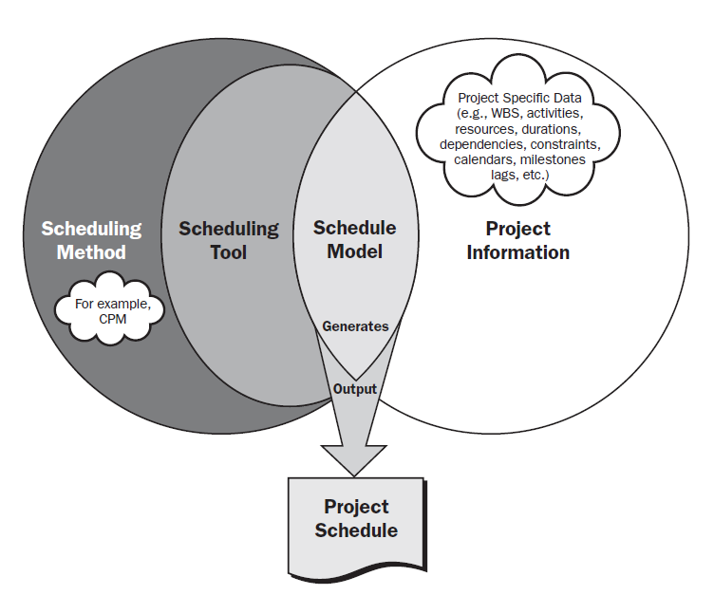

Slide 6
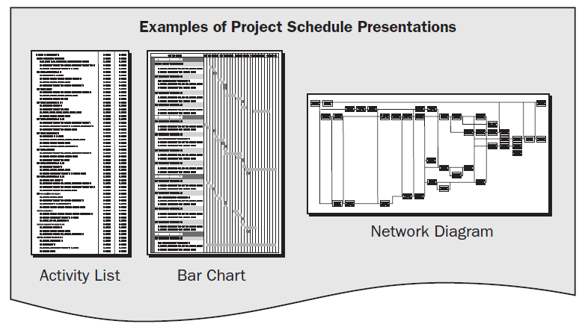

Slide 7
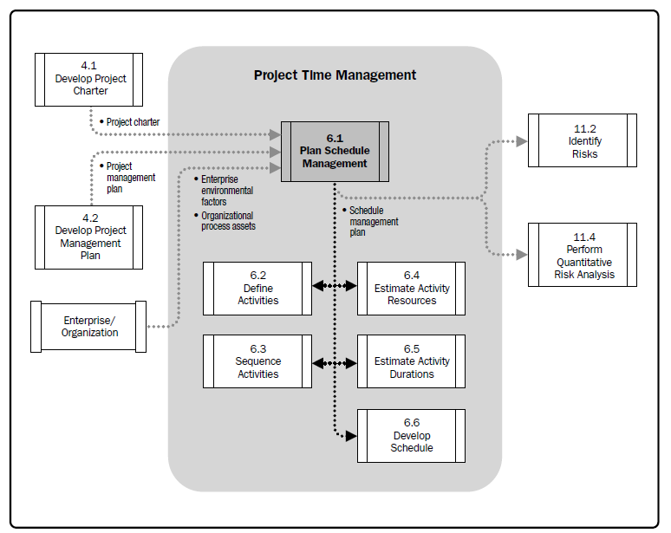

Slide 8
Introduction [3/3]
Plan Schedule Management
Define Activities
Sequence Activities
Estimate Activity Resources
Estimate Activity Durations
Develop Schedule
Control Schedule

Slide 9
Process 1: Plan Schedule Management
The process of establishing the policies, procedures, and documentation for planning, developing, managing, executing, and controlling the project schedule.
Guidance and direction on how the project schedule will be managed
Formal/informal, highly detailed or broadly framed
How schedule contingencies will be reported and assessed
Plan may be updated to reflect the change
Figure source: Software Extension to PMBOK® Guide – Fifth Edition, PMI, 2013, pp. 90

Slide 10
Plan Schedule Management: Inputs [1/2]
Project management plan
Scope baseline
scope statement and work breakdown structure (WBS)
Other information
cost, risk, and communications decisions
Project charter
summary milestone schedule and project approval
Enterprise environmental factors
Organizational culture and structure can all inﬂuence schedule management
Resource availability and skills that may inﬂuence schedule planning
Project management software provides the scheduling tool and alternative possibilities for managing the schedule
Published commercial information, such as resource productivity information, is often available from commercial databases that track
Organizational work authorization systems
Software project portfolios
Enterprise architectures

Slide 11
Plan Schedule Management: Inputs [2/2]
Organizational process assets
Monitoring and reporting tools to be used
Historical information
Schedule control tools
Existing formal and informal schedule control related policies, procedures, and guidelines
Templates
Project closure guidelines
Change control procedures
Risk control procedures
Safety and Security Issues
Public safety and cyber security issues
safety and security regulations, standards, policies, and requirements

Slide 12
Plan Schedule Management: Tools and Techniques
Expert judgment
Expertise in an application area, knowledge area, industry etc.
Analytical techniques
scheduling methodology, scheduling tools and techniques, estimating approaches, formats, and project management software
Meetings
project manager, project sponsor, selected project team members, selected stakeholders, anyone with responsibility for schedule planning or execution, and others as needed

Slide 13
Plan Schedule Management: Outputs
Schedule management plan
Project schedule model development
Level of accuracy
Units of measure
Organizational procedures links
Project schedule model maintenance
Control thresholds
Rules of performance measurement
Reporting formats
Process descriptions

Slide 14
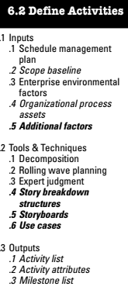
Process 2: Define Activities
The process of identifying and documenting the specific actions
A basis for estimating, scheduling, executing, monitoring the work
Figure source: Software Extension to PMBOK® Guide – Fifth Edition, PMI, 2013, pp. 90

Slide 15
Define Activities: Inputs
Schedule management plan
Scope baseline
Organization’s enterprise architecture
Enterprise environmental factors
Organizational cultures and structure
Published commercial information from commercial databases
Project management information system (PMIS)
Organizational process assets
Additional factors
Existing work orders and enhancement requests; technical debt remaining from previous work, incomplete functionality, and needed rework; business process changes; and activities external to a software project such as database or operating system upgrades

Slide 16
Define Activities: Tools and Techniques
Decomposition
Dividing the project scope and deliverables into smaller, more manageable parts
Work packages in WBS are decomposed into activities
Activities represent the effort needed to complete a work package.
Rolling wave planning
Expert judgment
Story breakdown structure
User stories
Epic and themes
Procurement, documentation, risk management etc. based on stories
Storyboards
Use cases

Slide 17
Define Activities: Outputs [1/2]
Activity list
Comprehensive list of all schedule activities having identifier and scope of work
Coordination with entities external
Activity attributes
Multiple components associated with an activity
Activity identifier (ID), WBS ID, activity label, activity codes, activity description, predecessor activities, successor activities, logical relationships, leads and lags, resource requirements, imposed dates, constraints, and assumptions
Dependencies and enabling precedent activities
Stakeholder value or priority
Estimated effort, size, complexity, and/or risk
Security and/or safety standards and constraints
Special competencies required of project team members and others

Slide 18
Define Activities: Outputs [2/2]
Milestone list
Milestone is a significant point or event in a project
List contains all milestones of a project
Mandatory or optional
Zero duration
Anchor points in software development life cycle
Predictive software development: requirements and architectural design reviews, customer reviews, and product delivery
On-demand scheduling methods: no milestones, customer satisfaction
Define joint milestones with interdependent projects to reduce project risk

Slide 19
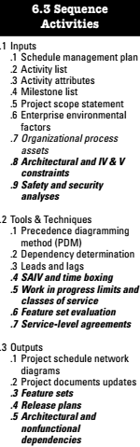
Process 3: Sequence Activities
Process of identifying and documenting relationships among the activities
The logical sequence of work to obtain the greatest efficiency
Software projects are different in nature
Dependencies on database structure and infrastructure needs etc.
Establish and refine the operational concepts, to build prototypes, to define architecture
Depends on the familiarity, size, and complexity of the software product
Software architecture has a significant impact
Software schedules are frequently revised
Unscheduled prototyping, code experimentation, “dark matter”
Figure source: Software Extension to PMBOK® Guide – Fifth Edition, PMI, 2013, pp. 90

Slide 20
Sequence Activities: Inputs
Schedule management plan
Activity list
Activity attributes
Milestone list
Project scope management
Enterprise environmental factors
Organizational process assets

Slide 21
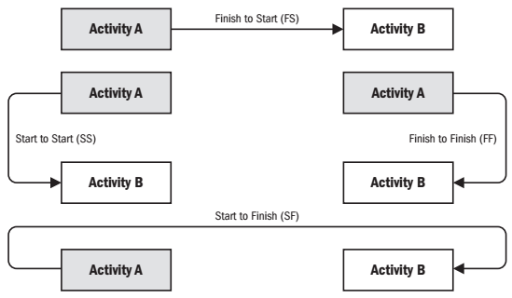
Sequence Activities: Tools and Techniques [1/4]
Precedence Diagramming Method (PDM)
Activities represented as nodes and are linked by logical relationships
Activity-on-Node (AON)
Types of dependencies / logical relationship
Finish-to-start (FS)
Award ceremony cannot start until the race has finished
Finish-to-finish (FF)
Document writing is required to finish before editing the document can finish
Start-to-start (SS)
Level concrete cannot begin until pour foundation begins
Start-to-finish (SF)
The first security guard shift cannot finish until the second security guard shift starts
Figure source: PMBOK® Guide – Fifth Edition, PMI, 2013, pp. 157

Slide 22
Sequence Activities: Tools and Techniques [2/4]
Dependency determination
Mandatory dependencies
Hard logic, hard dependencies
Legal, contractual, or inherent
Discretionary dependencies
Preferred logic, preferential logic, soft logic
Based on knowledge of best practices
Should be fully documented
External dependencies
Relationship between project and non-project activities
Internal dependencies
Precedence relationship between project activities

Slide 23
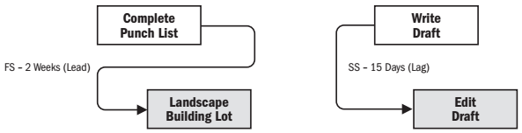
Sequence Activities: Tools and Techniques [3/4]
Leads and lags
Lead
The amount of time whereby a successor activity can be advanced with respect to a predecessor activity
Represented as a negative value for lag
Lag
The amount of time whereby a successor activity will be delayed with respect to a predecessor activity
Activities and their related assumptions should be documented
Figure source: PMBOK® Guide – Fifth Edition, PMI, 2013, pp. 158

Slide 24
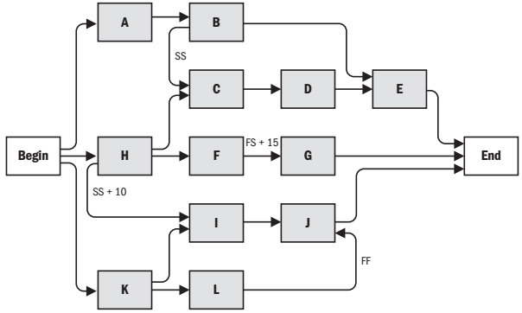
Sequence Activities: Outputs
Project schedule network diagrams
Graphical representation
Description should be associated for unusual sequence
Project documents updates
Activity lists and attributes, milestone list, and risk register
Features sets
Release plans
The overall project schedule of releases
Dependent on the production of the software team
Architectural and nonfunctional dependencies
Figure source: PMBOK® Guide – Fifth Edition, PMI, 2013, pp. 160

Slide 25
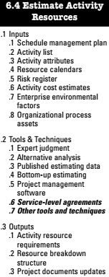
Process 4: Estimate Activity Resources
Estimating the type and quantities of material, people, equipment, or supplies
Identification of the type, quantity, and characteristics of resources required
More accurate cost and duration estimates
The skills and abilities of software developers are significant factors
Figure source: Software Extension to PMBOK® Guide – Fifth Edition, PMI, 2013, pp. 90

Slide 26
Estimate Activity Resources: Inputs
Schedule management plan
Activity list
Activity attributes
Resource calendars
Risk register
Activity cost estimates
Enterprise environmental factors
Resource location, availability, and skills
Organizational process assets

Slide 27
Estimate Activity Resources: Tools and Techniques
Expert judgment
Alternative analysis
Published estimating data
Bottom-up estimating
Project management software
Service-level agreements
Other tools and techniques
Algorithmic estimation models
Function point/story point/use-case estimation tools

Slide 28
Estimate Activity Resources: Outputs
Activity resource requirements
Types and quantities of resources required
Resource breakdown structure
Hierarchical representation of resources
Resource categories: labor, material, equipment, and supplies etc.
Resource types: skill level and grade level etc.
Project documents updates
Activity list and attributes, resource calendars

Slide 29
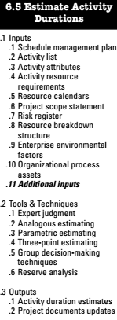
Process 5: Estimate Activity Durations
Estimating the number of work periods needed to complete activities
Factors affecting estimates in software projects
Intangibility of software
Broad variance in productivity of software developers
Need for changes to meet emergent requirements
The often unprecedented nature of the software product
Unknown competencies of the software team
Unknown hardware or software defects
The need to incorporate other software (legacy, commercial, open-source etc.)
Figure source: Software Extension to PMBOK® Guide – Fifth Edition, PMI, 2013, pp. 90

Slide 30
Estimate Activity Durations: Inputs
Schedule management plan
Activity list
Activity attributes
Activity resource requirements
Resource calendars
Project scope statement
Risk register
Resource breakdown structure
Enterprise environmental factors
Organizational process assets
Additional inputs
Customer stories and features organized into lists, groups, or sets
Velocity and rework metrics

Slide 31
Estimate Activity Durations: Tools and Techniques [1/2]
Expert judgment
Analogous estimating
Parametric estimating
Three-point estimating
Program Evaluation and Review Technique (PERT)
Most likely (tM): the average case scenario
Optimistic (tO): the best case scenario
Pessimistic (tP): the worst case scenario
Triangular distribution. tE = (tO + tM + tP) / 3
Beta distribution (from the traditional PERT technique). tE = (tO + 4tM + tP) / 6
Bottom Up Estimation

Slide 32
Estimate Activity Durations: Tools and Techniques [2/2]
Group decision-making techniques
Voting
Fist to five
Reserve analysis
Contingency reserves
“Known-unkowns”
a percentage of the estimated activity duration, a fixed number of work periods, or may be developed by using quantitative analysis methods such as Monte Carlo simulation
May be used, reduced, or eliminated based on more precise information
Included in schedule documentation
Management reserves
Withheld for management control purposes
“Unknown unkowns”
Not included in schedule baseline

Slide 33
Estimate Activity Durations: Outputs
Activity duration estimates
Quantitative assessment of time required to complete the activity
Lags are not included
Range of time e.g. 2 week + 2 days or 15% probability of exceeding three weeks
Project documents updates
Project documents that may be updated include, but are not limited to:
Activity attributes; and
Assumptions made in developing the activity duration estimate, such as skill levels and availability, as well as a basis of estimates for durations.

Slide 34
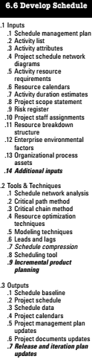
Process 6: Develop Schedule
Process of analyzing activity sequences, durations, resource requirements, and schedule constraints to create the project schedule model
Iterative process
Different presentation forms of project schedules are possible
Software project schedules and plans change
Customer requests
Project feedback
The emergence of previously unidentified work activities
Figure source: Software Extension to PMBOK® Guide – Fifth Edition, PMI, 2013, pp. 90

Slide 35
Develop Schedule: Inputs [1/2]
Schedule management plan
Activity list
Activity attributes
Project schedule network diagrams
Activity resource requirements
Resource calendars
Activity duration estimates

Slide 36
Develop Schedule: Inputs [2/2]
Project scope statement
Risk register
Project staff assignments
Resource breakdown structure
Enterprise environmental factors
Organizational process assets
Additional inputs

Slide 37
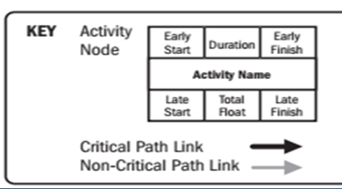
Develop Schedule: Tools and Techniques [1/5]
Activity/Task | Duration | Precedence
A | 5 | --
B | 5 | A
C | 10 | A
D | 15 | B,C
1 | 5 | 5
A
1 | 0 | 5

Slide 38
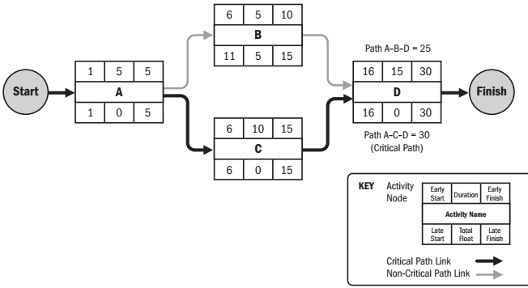
Develop Schedule: Tools and Techniques [1/6]
Schedule network analysis
Critical path method
Estimate the minimum project duration and determine the amount of scheduling ﬂexibility on the logical network paths within the schedule model
Calculates the early start, early finish, late start, and late finish dates for all activities
The longest path is the critical path
The shortest possible project duration
Critical path is normally characterized by zero total ﬂoat
Activity on the critical path: critical path activity
Free float: free time that an activity can be delayed
without delaying the early start date of any successor
Figure source: PMBOK® Guide – Fifth Edition, PMI, 2013, pp. 177

Slide 39
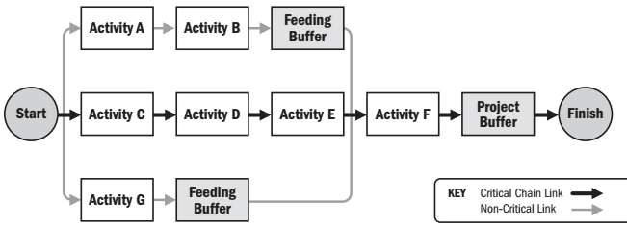
Develop Schedule: Tools and Techniques [2/5]
Critical chain method
Inclusion of buffers on any project schedule path
Critical chain: resource-constrained critical path
Buffer: non-work schedule activity
Project buffer: at the end of the critical path
Feeding buffer: at the entry point at the critical path
Figure source: PMBOK® Guide – Fifth Edition, PMI, 2013, pp. 178

Slide 40
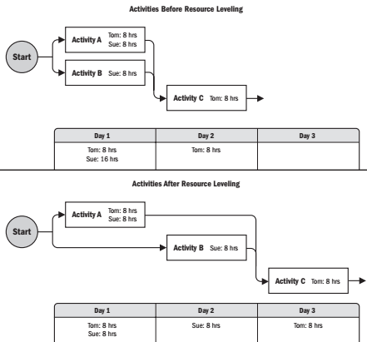
Develop Schedule: Tools and Techniques [3/5]
Resource optimization techniques
Resource leveling
Adjusting start and end dates to balance resources demand
Availability of shared or critically required resource at certain times
Cause the original critical path to change, usually to increase
Resource smoothing
Adjusting the activities to not exceed predefined resource limits
Critical path is not changed
Activities are delayed within their free and total float
Figure source: PMBOK® Guide – Fifth Edition, PMI, 2013, pp. 179

Slide 41
Develop Schedule: Tools and Techniques [4/5]
Modeling techniques
What-if scenario analysis
Evaluating scenarios to predict their effect on project objectives
Assess the feasibility of the project schedule under adverse conditions
Simulation
Calculating multiple project durations with different sets of activity assumptions
Monte Carlo analysis
Leads and lags
Resource Leveling and Resource Smoothing

Slide 42
Develop Schedule: Tools and Techniques [5/5]
Schedule compression
Shorten the schedule duration without reducing the project scope
Crashing
Add resources by the least incremental cost
Overtime, additional resources, quick payments
Not necessarily better alternative
Fast tracking
Activities are performed in parallel rather than in sequence
May result in rework and increased risk
Software projects rarely succeed when the project schedule is compressed more than 25%
Brooks law: “adding manpower to a late project makes it later.”
For adaptive software projects: reduce the features planned or less functionality within a feature
Scheduling tool
Incremental product planning

Slide 43
Develop Schedule: Outputs [1/2]
Schedule baseline
The approved version of a schedule
Project schedule
Master/milestone schedule
Different presentation forms
Bar charts (Gantt charts)
Milestone charts
Project schedule network diagrams
Schedule data
Schedule milestones, schedule activities, activity attributes, and documentation of all identified assumptions and constraints
Resource requirements by time period, often in the form of a resource histogram
Alternative schedules, such as best-case or worst-case, not resource-leveled, or resource-leveled, with or without imposed dates
Scheduling of contingency reserves

Slide 44
Develop Schedule: Outputs [2/2]
Project calendars
Identification of working days and shifts for scheduled activities
Project management plan updates
Project documents updates
Release and iteration plan udpates

Slide 45
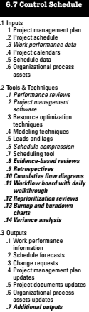
Process : Control Schedule
Challenging task to control the schedule
Determining the current status of the project schedule
Inﬂuencing the factors that create schedule changes
Determining if the project schedule has changed
Managing the actual changes as they occur
Factors that affect software project schedule
The rate that teams are delivering completed software increments
The current rate of completion for work in process
The risks and dependencies that can impact the schedule
The impact of technical variance on the schedule
Options for reprioritizing product scope
Figure source: Software Extension to PMBOK® Guide – Fifth Edition, PMI, 2013, pp. 90

Slide 46
Control Schedule: Inputs
Project management plan
Project schedule
Work performance data
Project calendars
Schedule data
Organizational process assets
Existing formal and informal schedule control-related policies, procedures, and guidelines
Schedule control tools
Monitoring and reporting methods to be used

Slide 47
Control Schedule: Tools and Techniques [1/2]
Performance reviews
Trend analysis
Critical path method
Critical chain method
Earned Value Management (EVM)
Technical review cycle
Project management software
Resource optimization techniques
Modeling techniques
Leads and lags
Schedule compression
Schedule tool

Slide 48
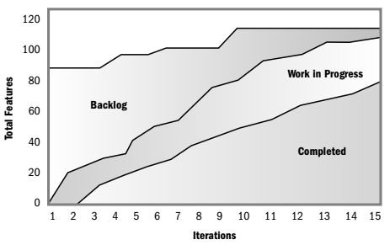
Control Schedule: Tools and Techniques [2/2]
Evidence-based reviews
Retrospectives
Cumulative flow diagrams
Workflow board with daily walkthrough
Reprioritization reviews
Burnup and burndown charts
Variance analysis
Figure source: Software Extension to PMBOK® Guide – Fifth Edition, PMI, 2013, pp. 115

Slide 49
Control Schedule: Outputs
Work performance information
Schedule forecasts
Change requests
Project management plan updates
Project documents updates
Organizational process assets updates
Additional outputs

Slide 50
https://www.tutorialspoint.com/management_concepts/leads_lags_floats.htm
https://pmstudycircle.com/2013/02/lead-time-and-lag-time-in-project-scheduling-network-diagram/
https://pmstudycircle.com/2014/02/critical-chain-method-ccm-in-project-management/

Slide 51
EXTRA

Slide 52
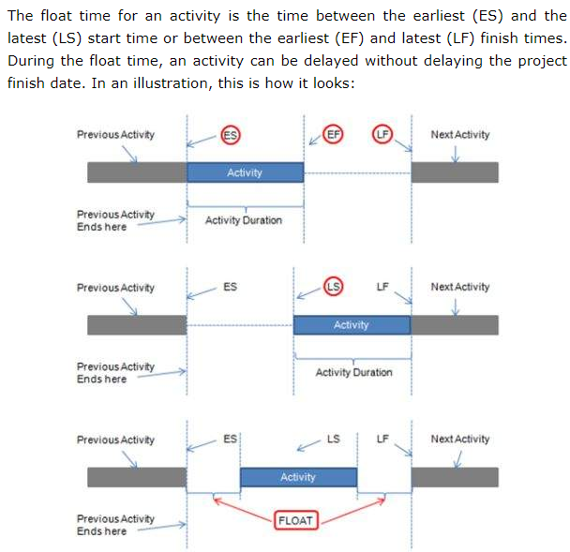

Slide 53
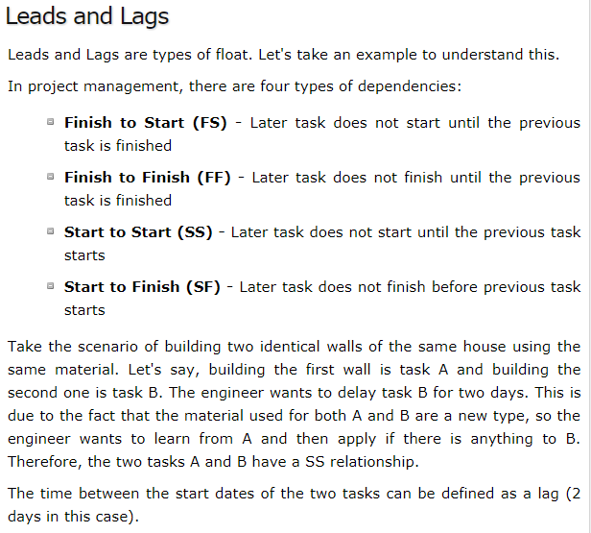

Slide 54
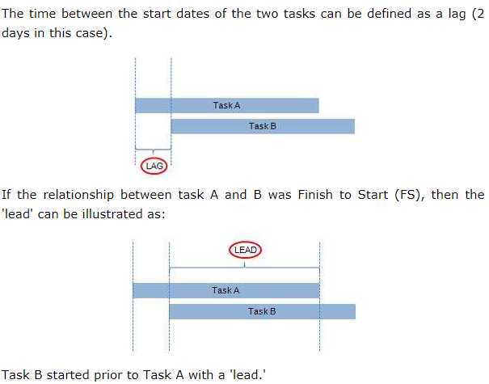

Slide 55
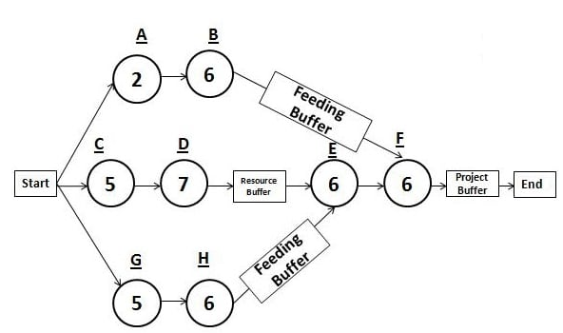


Slide 56
Project Buffer
This buffer is placed between the last task and the project completion date as a non-activity buffer, and this buffer acts as a contingency for the critical chain activities.
Any delay on the critical chain will eat this buffer, but the project completion date will remain unchanged. Also, if there is any gain from the early finish of any activity, this gain will be added to this buffer as well.
Usually the duration of this buffer is 50% of the contingency that you have removed from each task estimate. This helps you move uncertainty from each task to the project buffer.
Please note that, although the critical chain starts from the beginning, it ends before the start of the project buffer. It does not end at the end of the project. This duration will include any time duration borrowed from the project buffer or exclude the duration added to the buffer

Slide 57
Feeding Buffers
These buffers are added to the non-critical chain so that any delay on the non-critical chain does not affect the critical chain.
They are inserted between the last task on a non-critical chain and the critical chain.
Feeding buffers are also calculated the same way as the project buffer.
The duration of these buffers is based on some fraction of the safety removed from the tasks on non-critical chains.

Slide 58
Resource Buffer
These buffers are kept alongside the critical chain to make sure that they are available when they are required.
This buffer can be a human resource or any equipment.
Please note that, since the critical chain considers the resource constraints as well, it may be longer than the critical path schedule.
However, this might be compensated by removing the contingencies from the activities. Resources used in critical chain are known as critical resources

Slide 59
Difference Between Buffer and Float (or Slack)
Float or slack is a critical path phenomenon, and buffer belongs to critical chain.
Float is the difference between the duration of the critical path and non-critical path. On a critical path, float is zero.
Buffer is based on contingencies. For example, the project buffer is about 50% of the safety time that you have removed from the activity estimate duration. As per the definition of buffer, it is not zero on a critical chain or any other chain.

Slide 60
Difference Between Buffer and Float (or Slack)
Float is the same for all activities on a non-critical path, any activity can consume it partially or fully, and balance can be utilized by other activities. There is no further analysis.
Buffer can also be borrowed by any activity if the activity is delayed. The project manager analyzes the remaining buffer to find the status of the project.
Buffer can be divided into three categories: project buffer, feeding buffer and resource buffer. Float can be either total float or free float.

Slide 61
PERT – Program Evaluation and Review Technique
PERT is a statistical tool that is widely used in project management for developing the project schedule for very large, complex, and one time projects where usually no historical records are available to be reviewed
At first glimpse, you may think that PERT Diagram Method is similar to the critical path method; however, there are many differences between these two techniques, such as:

Slide 62
PERT – Program Evaluation and Review Technique
Critical Path Method (CPM) is activity oriented, while PERT is event oriented
Critical Path Method is used when you have definitive time estimate, while in PERT there is no certainty in time estimate
In CPM diagram, activity is shown on the node, while in PERT Diagram, activity is shown on the arrow, and nodes represent the milestones. (Therefore, PERT diagrams are also known as Activity on Arrow (AOA) diagram)
PERT Diagram can only have a “Finish to Start” type of relationship, while the CPM method can have any type of dependency; e.g. Start to Finish, Finish to Start, etc.
In CPM diagram, rectangles represent the nodes. In PERT diagram, circles represent nodes

Slide 63
PERT methodology is used mainly on very large and complex projects where time is a more important factor than the cost.
PERT is mainly used in research type projects where you cannot predict the time duration of any activity accurately; therefore, you have to plan your work based on the milestones.
The critical path method is a deterministic model where you use a fixed time estimate for activities.
CPM (critical path method) helps you run the project efficiently if the time estimates are definitive; however, if there is a variation in time estimate, it may affect your project badly.
The solution to this drawback of the CPM method is built into the PERT methodology, which helps you complete project successfully with less cost and time.

Slide 64
ACTIVITY ON ARROW
Task | Precedence | Duration
A | --------- | 3
B | --------- | 4
C | B | 7
D | A | 5
E | C | 2

Slide 65
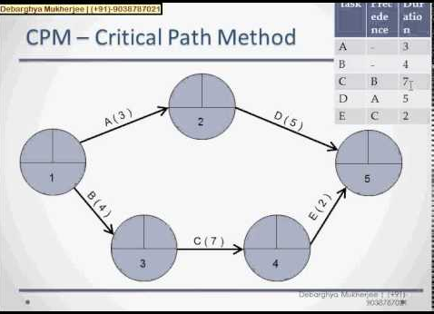

Slide 66

Normal Activity
Fast Tracking
Crashing
1 | 2 | 3 | 4 | 5 | 6
7 | 8 | 9 | 10 | 11 | 12
13 | 14 | 15 | 16 | 17 | 18
1 | 2 | 3 | 4 | 5 | 6
High Risk
5 | 6 | 7 | 8 | 9 | 10
9 | 10 | 11 | 12 | 13 | 14
1 | 2 | 3
High COST
4 | 5 | 6 | 7
8 | 9 | 10

Slide 67
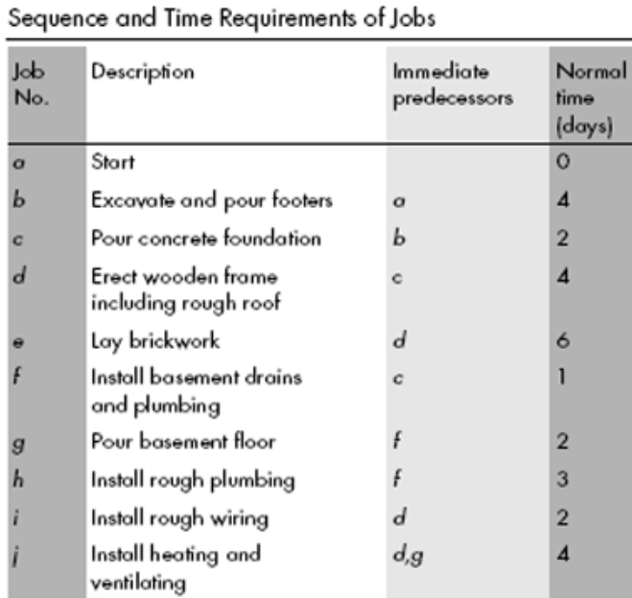

Slide 68
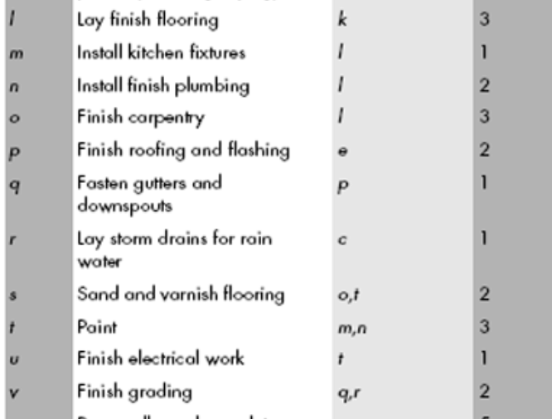

Slide 70
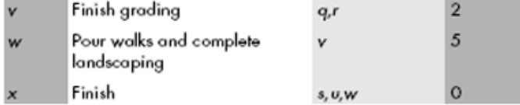

Slide 71
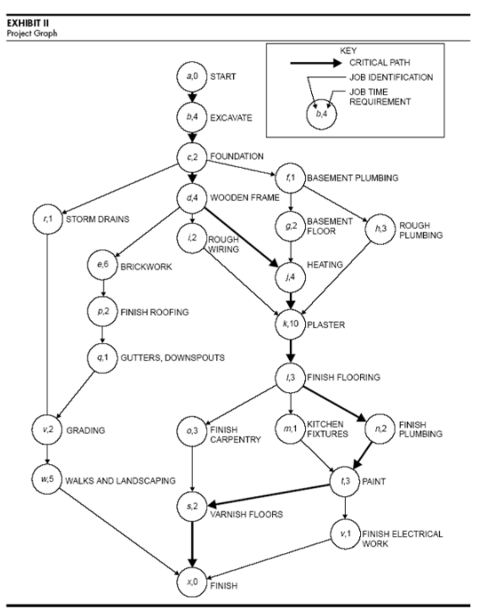

Slide 72
Must Go through
https://pmstudycircle.com/2014/01/critical-path-method-cpm-in-project-management/
https://pmstudycircle.com/2013/03/total-float-versus-free-float/

